Slide 1
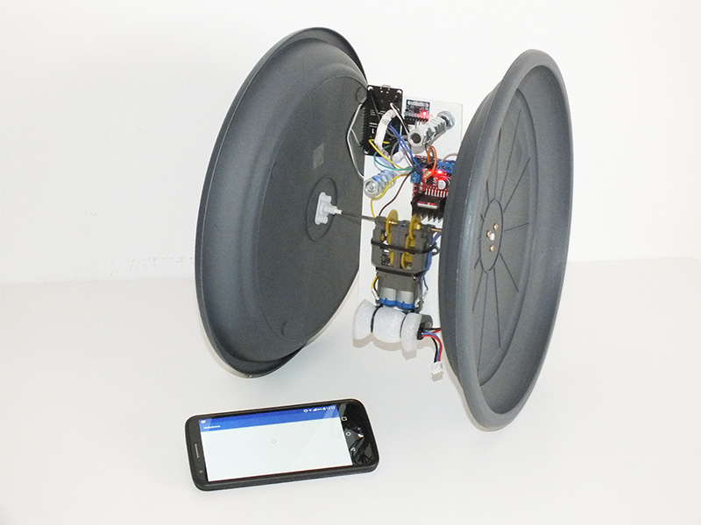
UNIBALANCE Remote controlLed self balancing bot
Stefano semeraro
Davide tarantino
Giorgio scarafile
CoURSe: robotics 2015/2016
TEACHER: prof. Giovanni indiveri

Slide 2
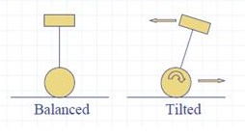
Unibalance summary
Unibalance is a robot that is able to constantly maintain an upright position also when external disturbances happen.
Utilizing a linear velocity sensor and an angular velocity sensor, it computes its angle above the horizon and turns the wheels to restore the equilibrium in the direction in which it’s falling when it’s out of its axis.
Beside an Android smartphone controls the Unibalance through WiFi connection pushing it forward, back and turning on self; this making it a nonholonomic veichle.

Slide 3
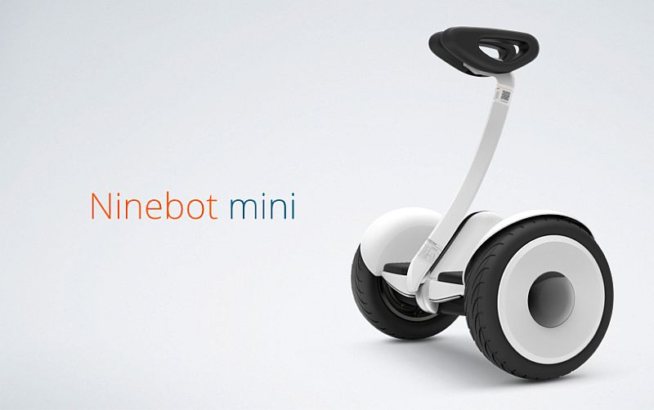
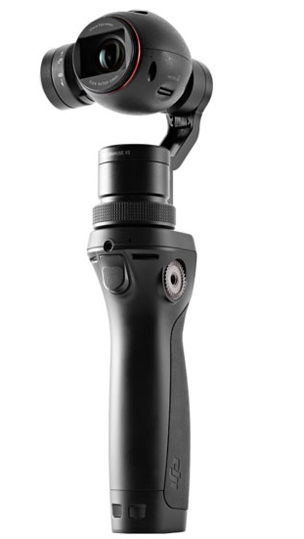
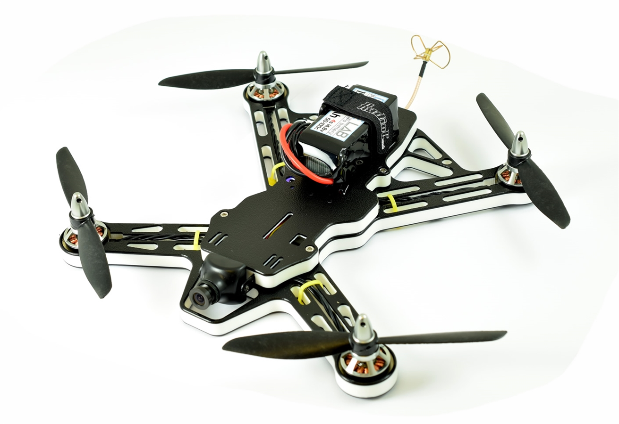
UTILIZATIONS
Unibalance is built on the top of a technology which is currently involved into a large number of projects thanks to decreasing cost of involved components, by this reason it’s experiencing exciting times in the commercial market.

Slide 4
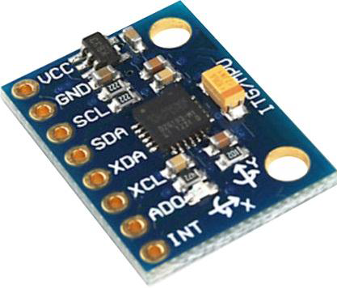
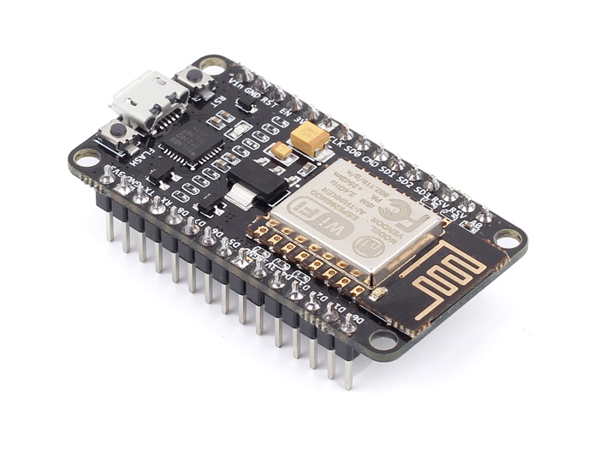
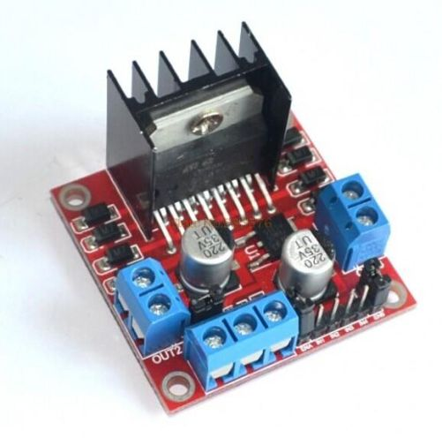
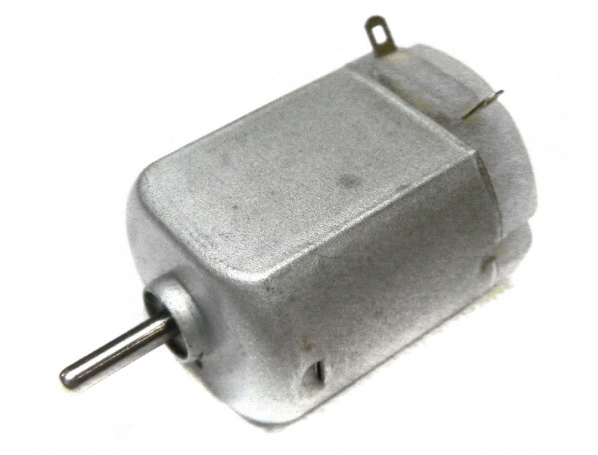
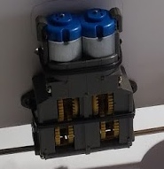
KEY COMPONENTS
6DoF SENSOR (accelerometer + gyroscope)
PROCESSING UNIT
MOTOR DRIVERS
DC MOTORS
GEARMOTOR

Slide 5
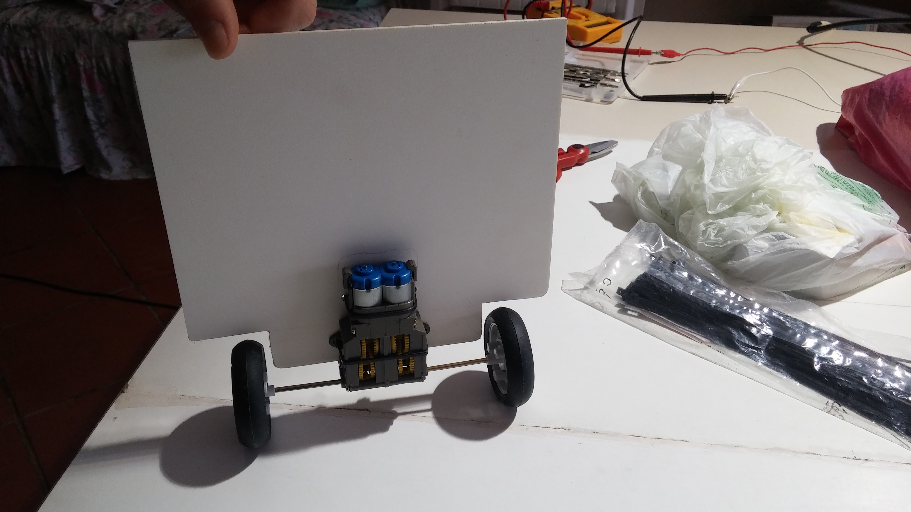
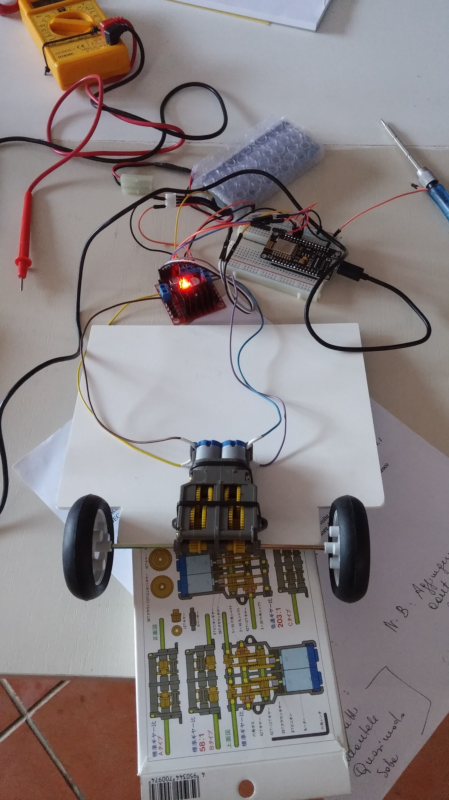
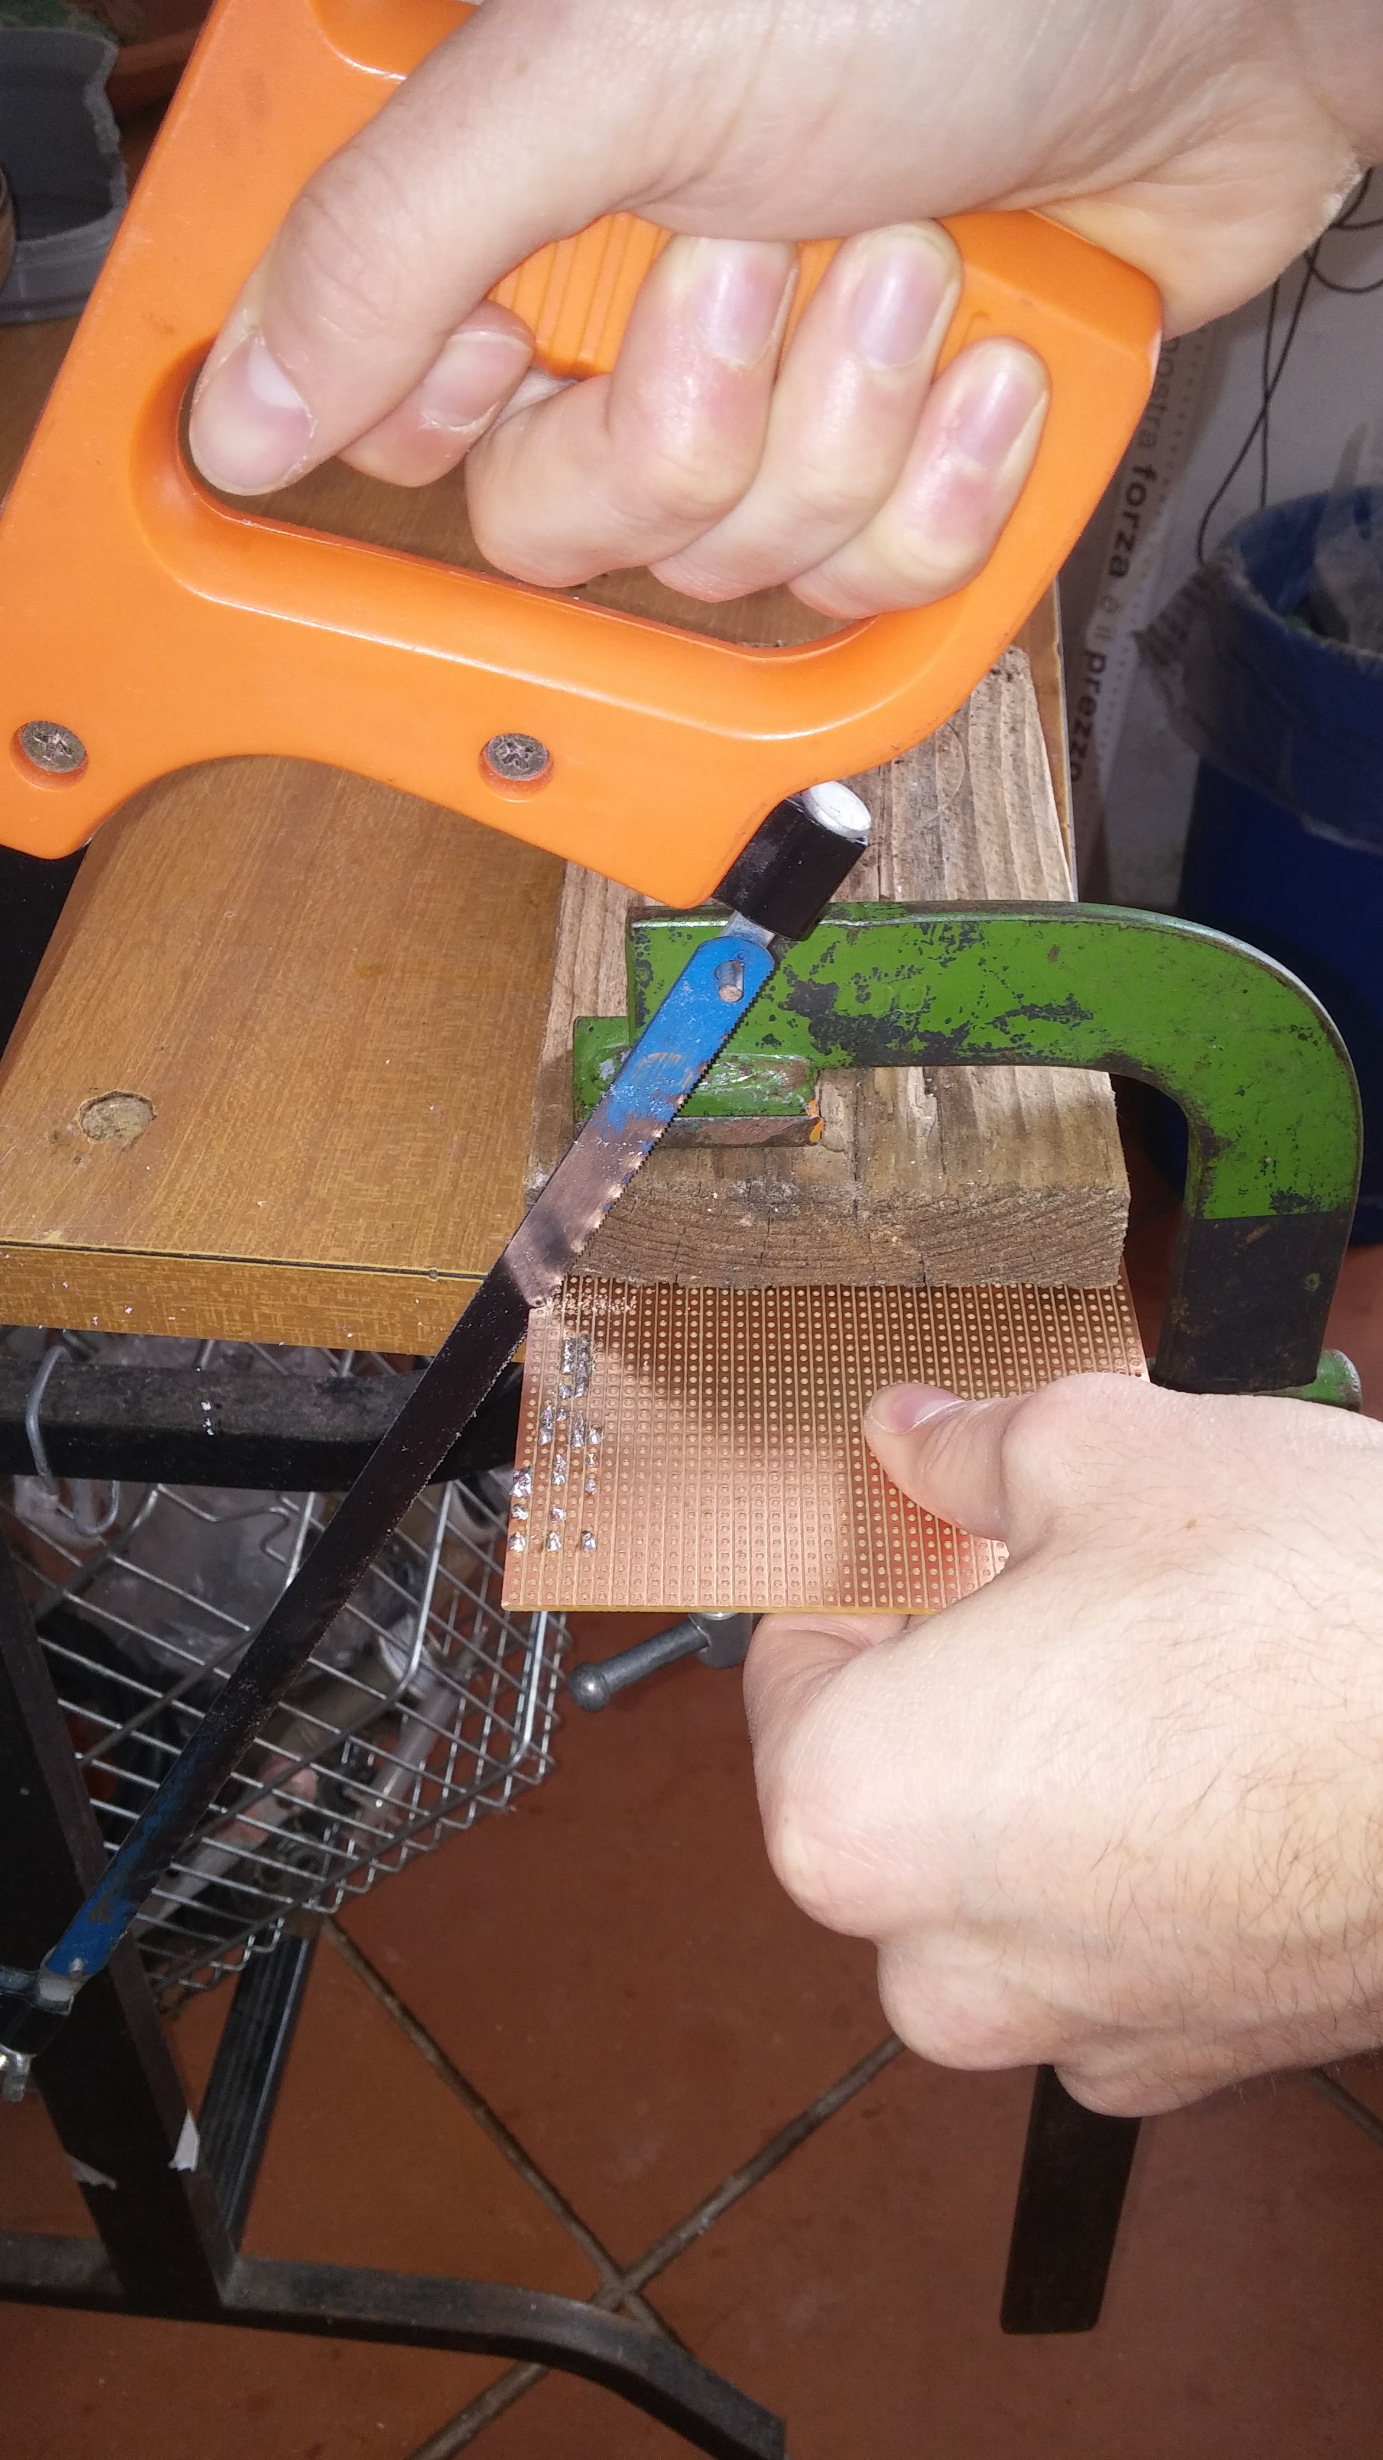
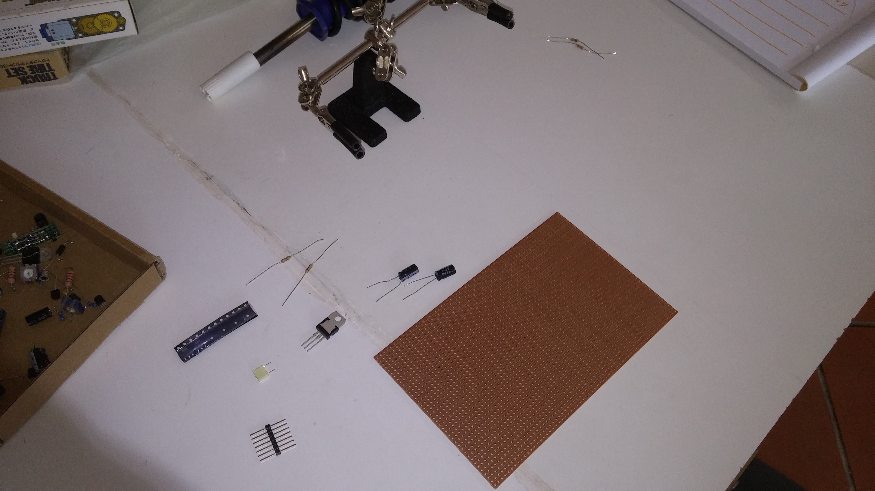
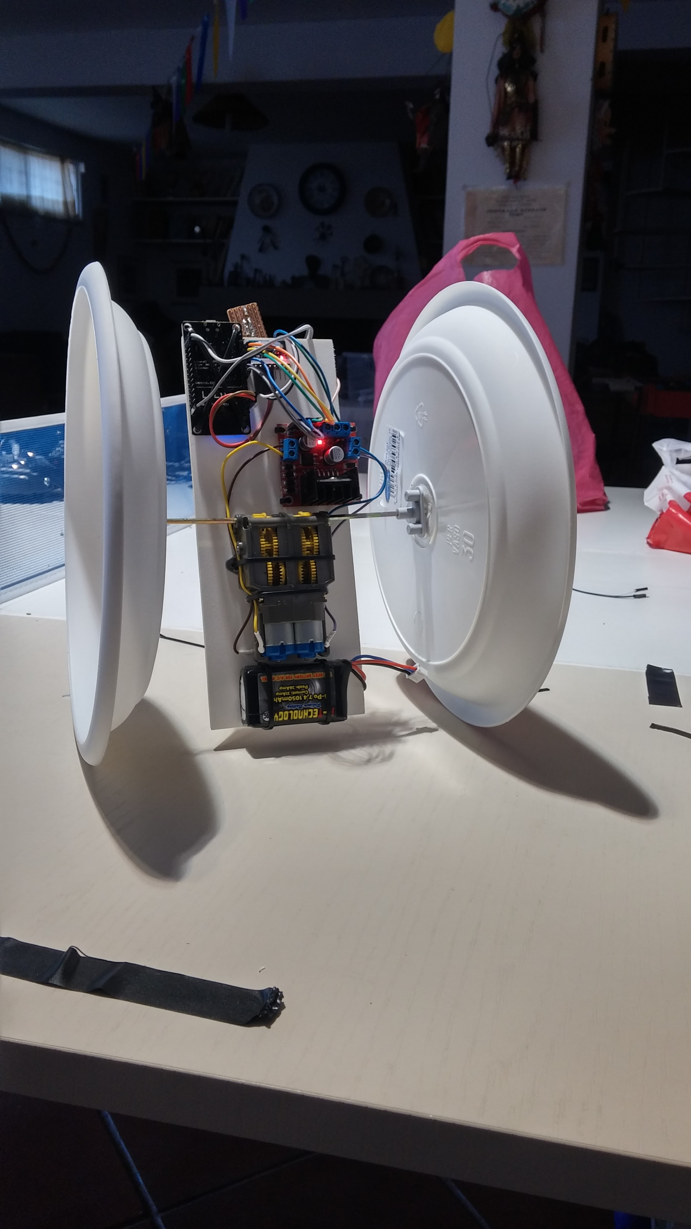
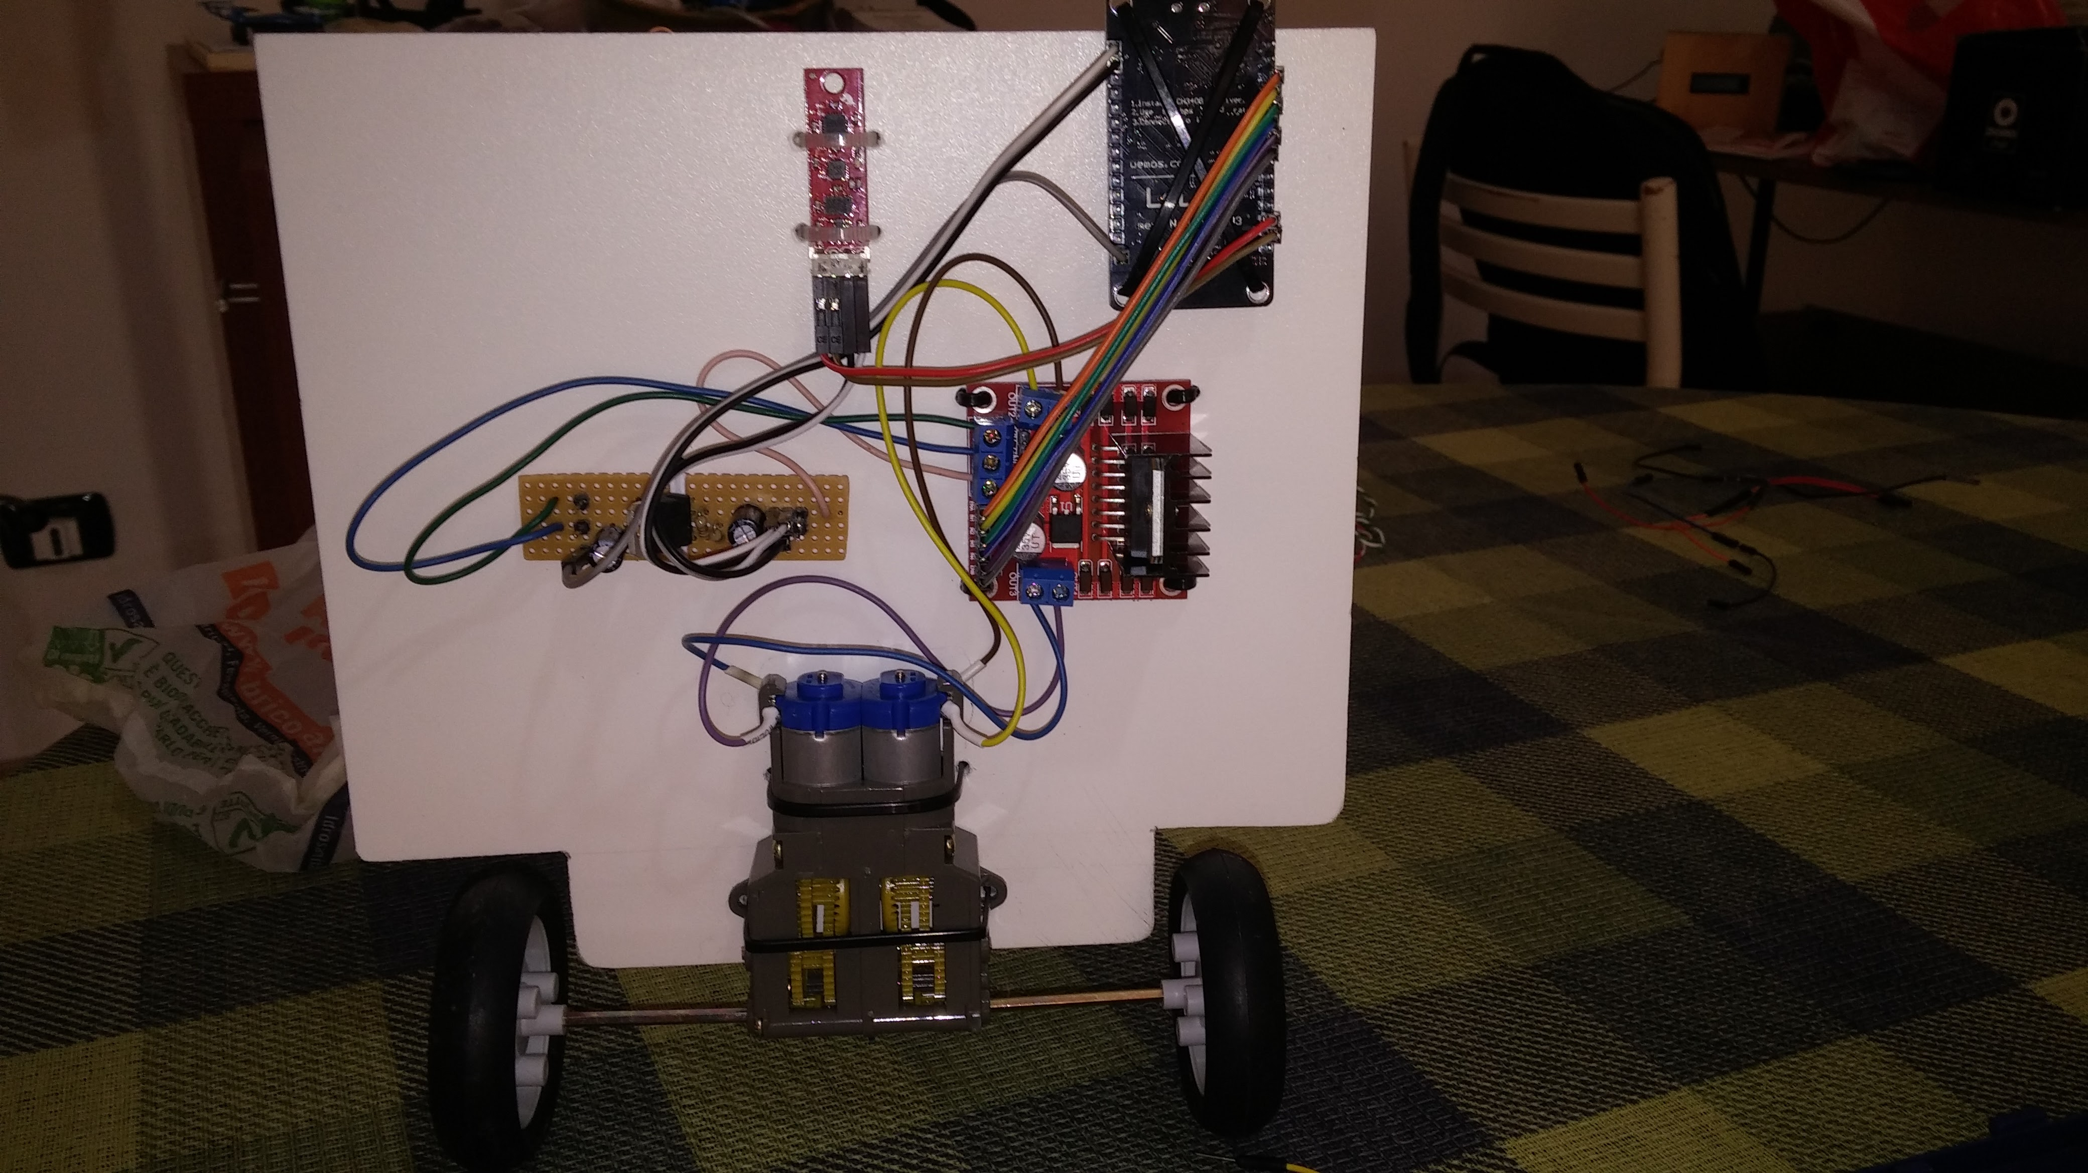
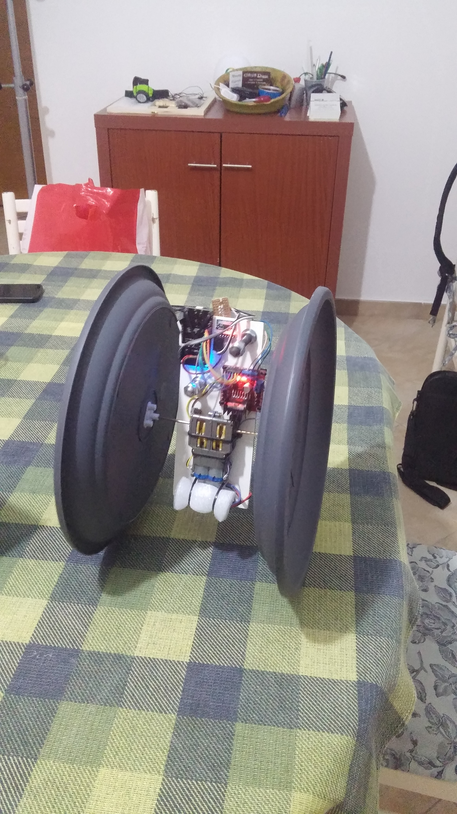
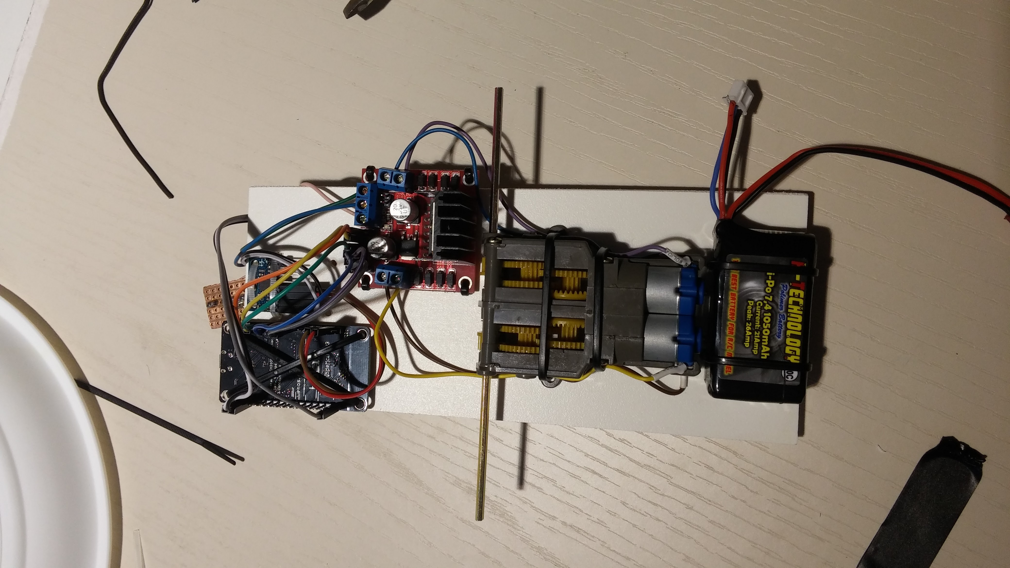
BUILDING
Overall weight: 600gr
Wheels diameter: 30cm
Width: 21cm

Slide 6
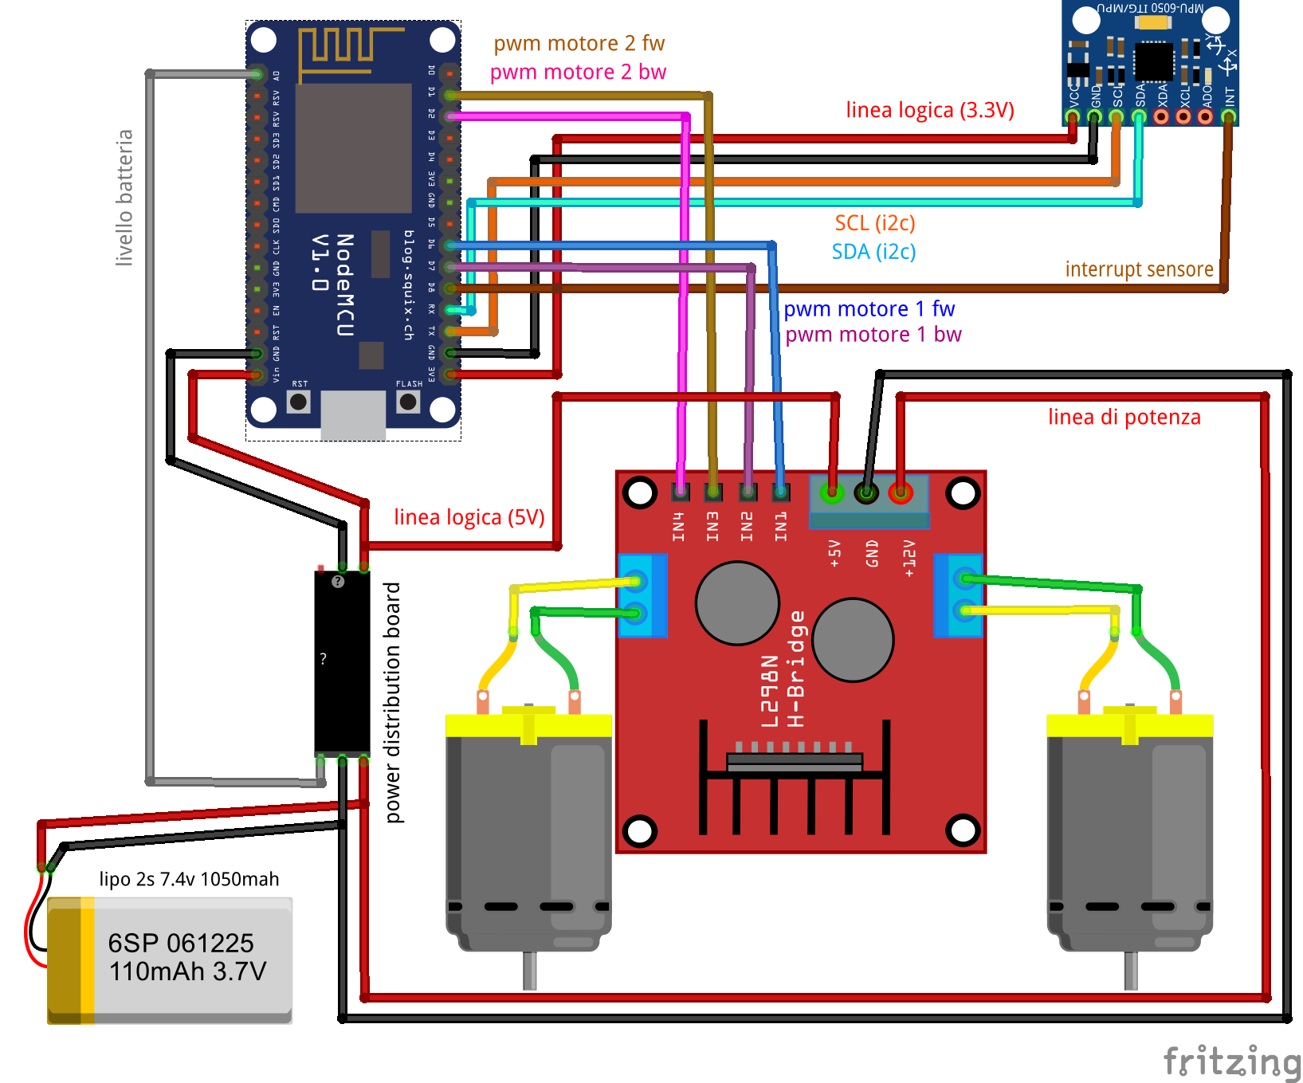
electrical schematic

Slide 7

POWER DISTRIBUTION AND FILTERING BOARD
The power distribution and filtering board has the following tasks:
To supply a stabilized 5v voltage needed by logic section of the circuit
To provide a certain number of current outputs (3x - 5.0v, 1x - 8.4v in our case) where to attach all devices circuit
To provide a stabilized output from where to read the battery voltage, according to the scale of the input range of the ADC (0 ~ 1.0v in our case)
In this project, the power distribution and filtering board it was projected and realized ad hoc

Slide 8
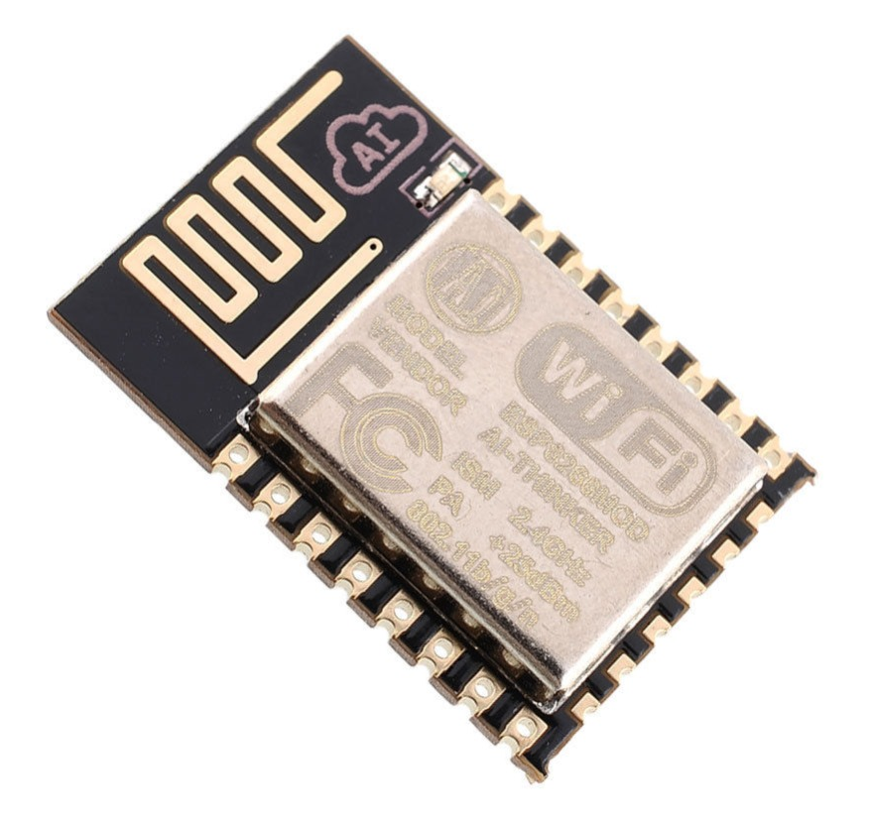
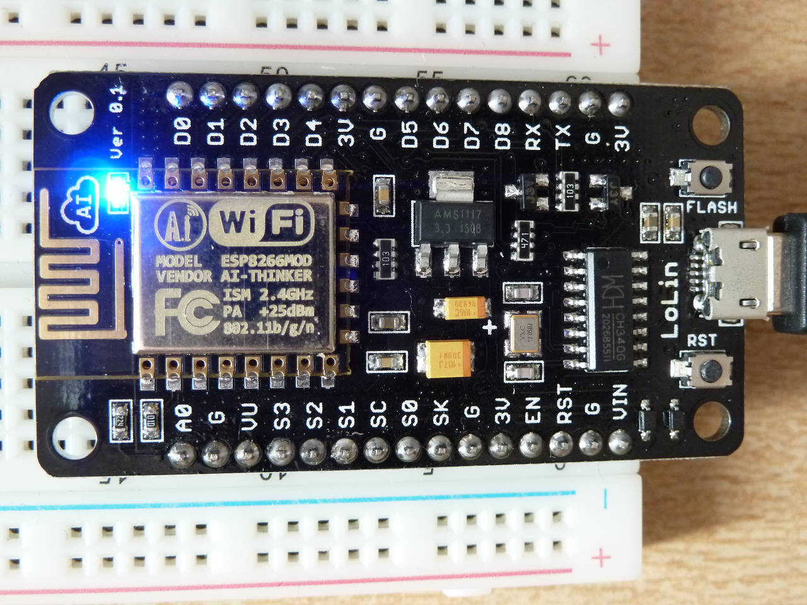
ON-BOARD MICROCONTROLLER
In Unibalance we opted for the chip ESP8266 of Espressif as on-board microcontroller. For practicality we used the development platform Nodemcu v3 that simplifies the using of the chip by providing an output USB for the programming, a circuit of regolation for the current and a suitable form factor for projects with a low cohesion level.

Slide 9
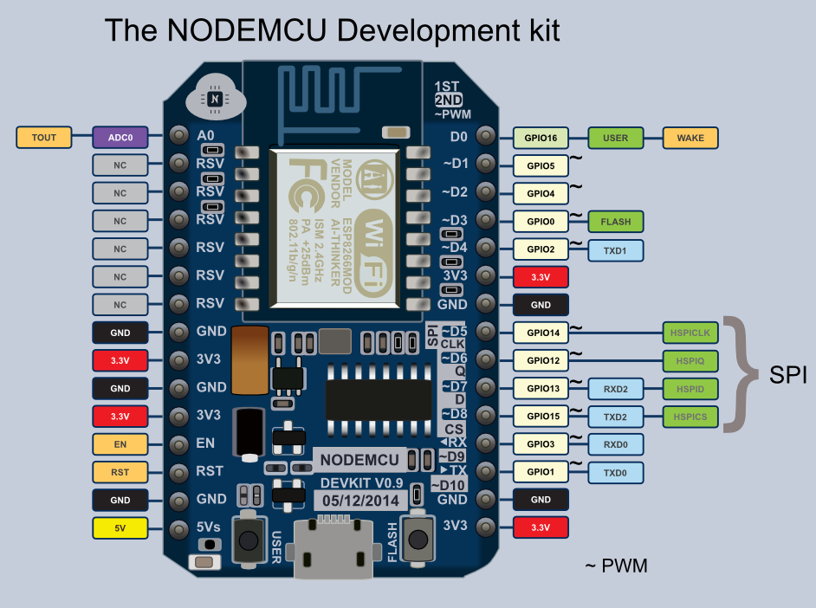
ON-BOARD MICROCONTROLLER (cont)
The pros of this chip are:
Integrated WiFi 2.4ghz (802.11 b/g/n) + TCP/IP prot
32bit RISC CPU with clock at 80mhz
96kb of SRAM
1/2/4M flash (4M in our version)
Low energy + sleep mode at 10uA
ADC, PWM, SERIAL, I2C, SPI, 1WIRE, INTERRUPT, TIMER and WATCHDOG bult-in
Supports LUA and C++ (we chose the last for computational efficiency purpose)
Very low cost (less than 3€)

Slide 10
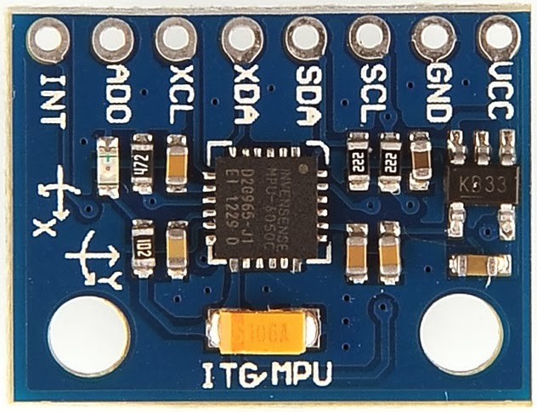
IMU SENSOR
A key role is played by the IMU (inertial measurement unit) sensor
In Unibalance we opted for the 6-axes accelerometer MPU6050 (3 of accelerometer and 3 of gyroscope) of InvenSense.
Thanks to the bult-in ADC at 16bit, IMU can estimate with an high resolution both the linear acceleration (with a variable full-scale from 2g, in our version, to 16g) and the angular velocity (with a minimum sensitivity of 200°/s).

Slide 11
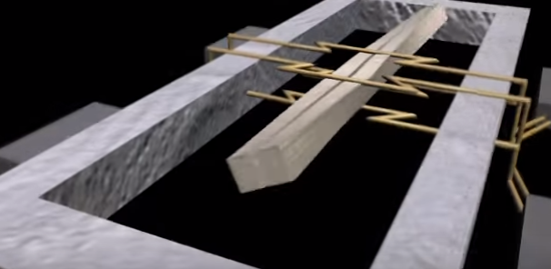
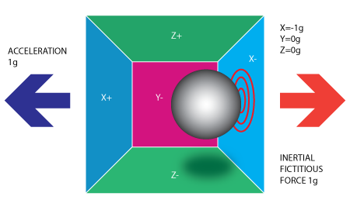
IMU SENSOR (cont)
It’s a sensor based on the MEMS (Micro Electro-Mechanical Systems) technology, which capture dynamics phenomena through piezoelectric effect.
It supports different communication protocols (we chose the i2c) and optionally provides an output of interrupt that is useful in applications which request low responce times (like this one)
It includes, also, a DMP (digital motion processor), which will be explained aftwerwards.
Finally, neither least, it can be bought with few euro.

Slide 12
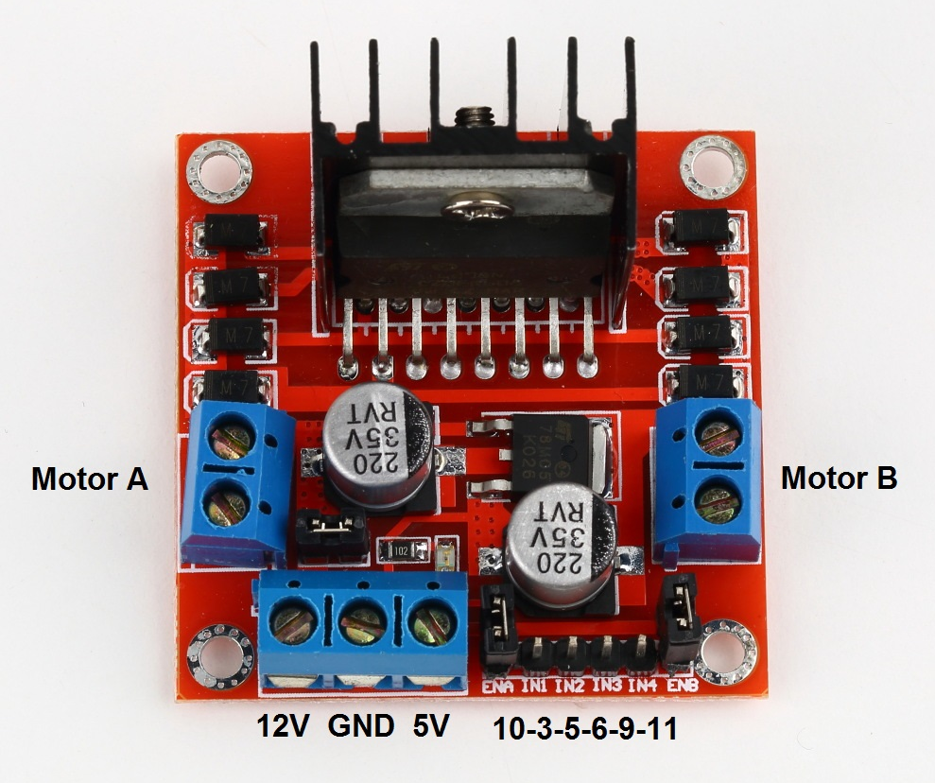
MOTOR DRIVERS IN CONTINUOUS CURRENT
To interface the microcontroller with the motors, we chose the chip L298N in the version with screw connectors and built-in heatsink.
The L298N is a dual H bridge with these features:
It can drive two motors
It's controlled by four inputs PWM (2 motors x 2 directions)
It can reverse the sense of rotation
It can control motors from 7v to 35v (also less by restricting the range of PWM; Unibalance owns 3v motors)
It supplies 2A at most for each motor
Optionally, it supplies a voltage of 5v useful when there isn't a power distribution board

Slide 13
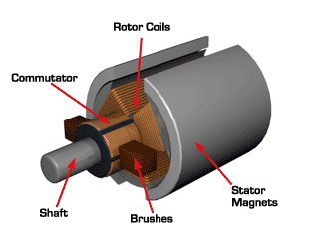
DC MOTORS AND GEARMOTORS
The used motors are simple 3v brushed.
Unluckily we didn’t find the specification of these motors and we had had to continue by individuating experimentally the working ranges (voltage and max load) through the measurement of the absorbed current and the temperature of the frame by varying the test conditions.
The gearmotor supplies a ratio of reduction of 58:1 and transforms the rotational motion from vertical to horizontal, after that it transmits the motion to the axle shafts in PVC connected to the two wheels.

Slide 14
CONTROL ARCHITECTURE
COMPASS
ROLL
STEER
SMARTPHONE
SENSORS
ANDROID SENSOR FUSION
LOW PASS FILTER
GYRO
ACCEL
PITCH
TILT
VERTICAL SETPOINT
ROBOT
IMU
LIN ACC
FILTER
+
PITCH
-
ANG VEL
+
ERROR
MOTOR SPEED AND DIRECTION CALCULATOR
PWM1
MOTOR 1
PID
OUTPUT
MOTOR DRIVER
PWM2
PWM3
PWM4
MOTOR 2

Slide 15
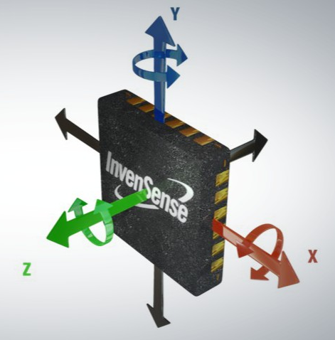
INCLINATION ESTIMATE
The critical point of a system that is able to autonomously mantain an upright position is certainly the inclination estimate respect to the horizon
The two useful sensor to accomplish this task are the accelerometer and the gyroscope.
At first sight could be appear sufficient to use the information obtained from the accelerometer to compose the gravity acceleration vector from its vertical and horizontal components.
Unluckily this solution can’t be realized because the accelerometers, by construction, are highly affected by noise, so it’s impossible to estimate the gravity accelaration vector during rotations.

Slide 16
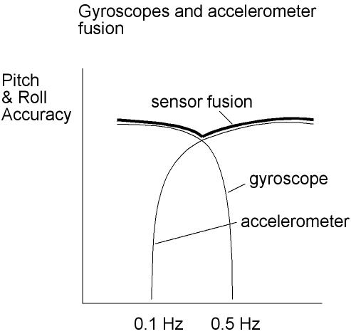
INCLINATION ESTIMATE (CONT)
Alternatively, could be possible to forward integrate (in mathematical meaning) the information obtained from the gyroscope, after did an initial leveling procedure.
It’s easy notice that this kind of solution might introduce drifting problematics just few seconds after the boot of the system.
We decided to follow the path of information fusion by testing filtering algorithms ever more precise until the achievement of an acceptable result. In particular:
Complementary filter
Kalman filter
Digital motion processing

Slide 17
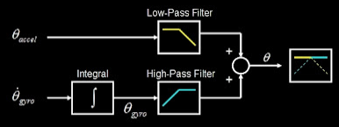
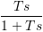
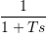
COMPLEMENTARY FILTER
A complementary filter allows to fuse information data which have accuracies disjoint in frequency.
It’s really appropriate in our case, in which the accelerometer works fine at low frequencies, unlike the gyroscope.
The main filter’s components are:
An integrator: it computes the angular position from the angular velocity read by the gyroscope
An high pass filter: it removes the characteristic bias of the gyroscope
A low pass filter: it removes the typical noise of the accelerometer
A frequency adder: it adds up the result of the two sensors after filtered them

Slide 18
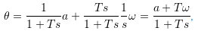
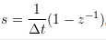
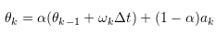
COMPLEMENTARY FILTER (CONT)
The filter equation is then:
Where
a is the arctan of the ratio between the acceleration components on the axis perpendicular plane of the wheels (i.e. the pitch estimation through only the accelerometer)
ω is the angular velocity on the axis of the pitch read by the gyroscope
T is the time constant which determines the cutoff frequency of inner filters.
Let’s the inverse transformation and discretizing by utilizing the backward difference method
We get the discrete time equation of the complementary filter:
where
that is α = T / (T + Δt), with Δt time interval between iterations

Slide 19
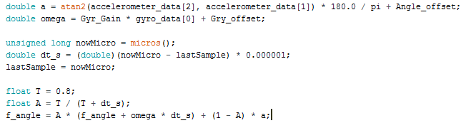
COMPLEMENTARY FILTER (CONT)
Our implementation of the complementary filter is been, hence, the following:
The bot stabilization performance by using the complementary filter to estimate the inclination are been rather good, except when the robot is been too manually solicited (in this case the robot flipped).
So we experimented other filtering techniques…

Slide 20
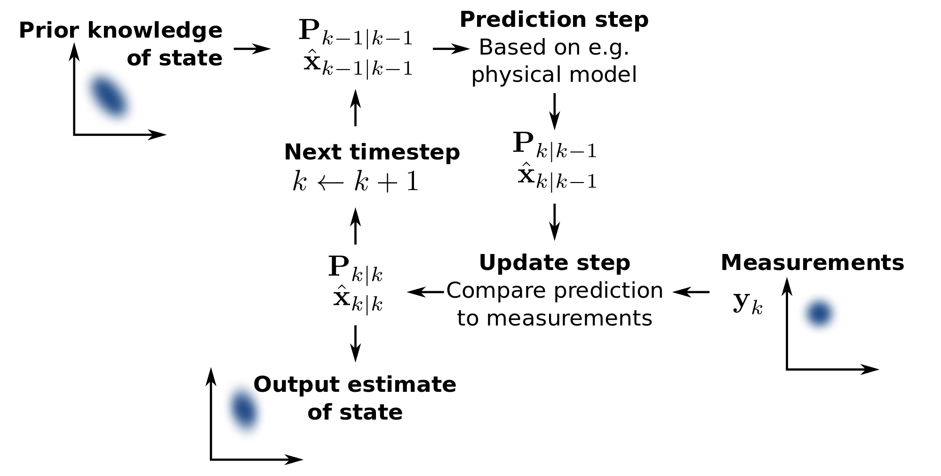
KALMAN FILTER
The Kalman filter is a recursive optimal estimator (if the measure noise and process noise are Gaussians, otherwise it’s anyway the best linear estimator).
It’s very popular in that:
it’s suitable for calculation in line
Its implementation is compact
It doesn’t require the inversion of the measure equation
It offers optimal results in practice

Slide 21
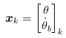
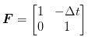
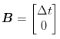
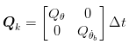
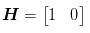
KALMAN FILTER (cont)
Let’s consider the state equation of our system:
where the first component of the state vector represents the pitch angle, the second is the bias (i.e. the drift of the gyroscope) and w_{k} Gaussian noise with zero mean and covariance matrix composed of the variances of the read angle from the accelerometer and of the bias of the gyroscope (considered, likely, indipendent); Note that the variance is multiplied by Δt in such a way that increases meanwhile which the information about the previous state become outdated.
The measure equation is instead:
and because the measure of the angular position is provided (directly) exclusively from the accelerometer, the observation model H and the covariance matrix of the measure noise R assume the simplified form presented to the side.
Finally, it’s likely, consider the variance of the measure noise as constant in the time.

Slide 22
KALMAN FILTER (CONT)
The Kalman filter acts, basically, maintaining some information about:
a posteriori estimate, that is the state estimation given the current measure and the previous
a priori estimate, that is the state estimation given the previous measures
and respective covariance matrices of the state
For what involves the a priori estimate (phase of prediction), it follows from the state equation that
where P is obviously a 2x2 matrix

Slide 23
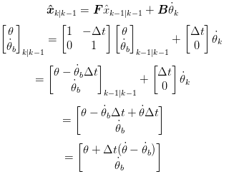
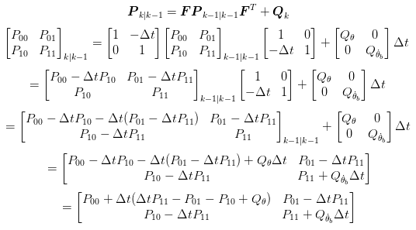
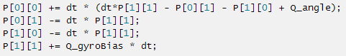
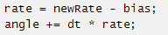
KALMAN FILTER (CONT)
The phase of prediction can be implemented in direct way simply expanding the two previous equations

Slide 24
KALMAN FILTER (CONT)
A bit more complicated is the a posteriori estimate (phase of updating).
Once obtained a new measure, we can, as first thing, calculate its difference with the a priori estimate calculated previously, by utilizing the observation model H (this quantity is called innovation):
(Remind that in our case the measure of the angular position is unidimensional because provided by the only accelerometer; In general case, the innovation is a matrix)
and its covariance:
Next, we calculate a quantity called gain of Kalman, which indicates, simplifying, how much confidence we give to the innovation according to its covariance. In our case the gain of Kalman is a 2x2 matrix.
Note: it’s easy to observe that, in the case in which the covariance of the innovation is high, the gain of Kalman will be represented by a low value and vice versa. The target of the previous equation is to project (through the observation model) the state covariance of the filter (P) into the space of measures, for the next comparison with the covariance of the innovation (S) specified by the multiplication for its inverse.

Slide 25
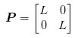
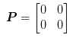
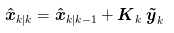
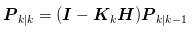
KALMAN FILTER (CONT)
At this point, happens the problem of how initialize the covariance of the state (P).
In general, we don't know the state at the start of the system, hence we can initialize P with an high value
In our case, switching on the bot in vertical position and having calibrated the sensor, we exactly determine the initial state (the state covariance is zero)
At this point we can show the equation of a posteriori estimate (that can be interpreted as the correction of a priori estimate through the new information on innovation weighted by the gain of Kalman):
And, finally, the update equation of the a posteriori state covariance (in this case the covariance matrix is adjusted in accord to how much we have improved the state estimation, information that is provided by the gain of Kalman projected into the states space through the observation model H)

Slide 26




Kalman filter (cont)
Also in this case, the updating phase can be implemented in a direct way extending the previous equations
Innovation
Innovation covariance
Kalman gain

Slide 27




Kalman filter (cont)

Slide 28


Kalman filter (cont)
In order that the kalman filter works correctly, it is neccessary to know the variances of the accelerometer, of the gyroscope and of the measurament process. These values are been measured experimentally for the majority of the sensors IMU available on the market. In particular, we found the following values for the MPU6050 module:
Even if the Kalman filter is based on a extremely more refined theory than the one of the complementary filter (in black), the experimental results obtained using the new filter (in green) are not so different. This confirm that the complementary filter is appropriated for this type of application.

Slide 29

DIGITAL MOTION PROCESSOR
The sensor IMU MPU6050 has inside a DMP (digital motion processor) dedicated, as we find trough our researches. The documentation of this processor is been released recently.
We decide to experiment the pitch calculation by this new technique, even if the DMP is based on a proprietary algorithm (closed-source) of sensor fusion, considering these aspects:
Being it developed by the same company that produces the IMU sensor is expected to represent the state of art as regards the handling of the information read by the sensor
We verified that a lot of commercial applications are based on DMP of InvenSense, this is a guarantee of the device quality.
The pitch calculation from a dedicated chip unload significantly the main microprocessor from the computational view point. In this way we achieve a saving in the calculation power for the WiFi communication and, above all, for the stabilization algorithm that is presented hereafter.

Slide 30
DIGITAL MOTION PROCESSOR (CONT)
For receiving data from the DMP it was necessary only to initialize the sensor with the right parameters. Some of them are: the sending frequency of data, choose in order not to saturate the microcontroller buffers and at the same time an order of magnitude more than the frequency of the control algorithm, to face possible delays. It’s added a simple communication logic, based on i2c protocol and a FIFO line, to receive data.
We find out and excellent result. It is in addition not so different from the one obtain from the two filters tested previously.
As we can sea from the following video, that show the comparison between a complemental filter (in red), the Kalman filter (in green) and DMP (in blue). We realised this comparison on Processing, with a scripting language for robotic application on common computer.
The outcomes of the first two filters are more or less identical, instead the DMP is more rapid in particular during sharper variation of pitch angle.
Finally we decided to adopt the DMP solution for Unibalance project.

Slide 31

DIGITAL MOTION PROCESSOR (CONT)

Slide 32

calibration
Calibration is a fundamental step to carry out for this typology of sensors. This procedure consist of reset the polarizations of the accelerometer and the gyroscope, after a resting position is set.
Indeed, there are numerous factors that have to be balanced, such as:
Different electro-mechanic characteristics of the chip analysed
The ambient temperature
The anomalies of the gravitational field
The method that we used in Unibalance project is composed by the following steps:
Centring the IMU sensor in bubble
Leave the IMU sensor at rest for 5 minutes in order to stabilized the chip temperature
Sample 1000 measurement of accelerometer and gyroscope
Averaging the measures obtained and balanced the resulted value inside the firmware bot

Slide 33

Stabilization algorithm
This application is appropriated for the use of PID controller (proportional integrated derivative) for the calculation of the exit.
This controller indeed despite the relative simplicity of implementation and a lower impact from the computation point of view (this is an important aspect in constrained environment), allow to achieve performance in line with the ones requested by the stabilization operation.
Taking into account the diffusion of the PID controllers, we decided to illustrate a brief insight on its working principles.
In particular we will explain some development details that allow us to overtake some problems run into the bot development such as derivate kick and the windup integral.

Slide 34

PID
The PID is a controller that works on negative feedback (the value read by the sensor placed on the exit is subtracted from the value of reference obtaining the error) and its exit value is obtained by the sum of three dimensions:
A proportional term: more is the error in a certain time moment more will be the strength needed for balance it.
A integral term: looking at the history of the error it manage to balance the possible offset of low frequencies.
A derivative term: need for damping the faster variations (higher frequency) and for mitigate phenomena of overshoot, caused by overcorrections of the error from the PID.
Each component as to be weighed through a parameter called gain. There are different techniques for the estimation of the optimal gains. During Unibalance project we used some simple rules by Ziegler-Nichols together with a trial and error approach.

Slide 35

PID (CONT)
A first implementation of the regulator is presented at the side.
Unfortunately we can easily highlight three recurrent problems:
The time interval from one iteration to another is not constant but depends on the moment in which the method Compute() is called inside the principal code bot; this deteriorate significantly the performances of the PID.
During the variation of the setpoint (recurrent situation in our project because this value is constantly sent by the smartphone) the derivative term assumed unexpected values (derivative kick)
The algorithm does not take into account that the output has to be limited considering the actuators used (in our case two small DC motors)

Slide 36

PID (CONT)
The first problem can be solved in a simple way: adding a controller that verify if the time settled before from an iteration to the other (PID period) is passed or not.
This modification need that the Compute() method is called at least one time during the PID period. However, this solution has the strength to eliminate the temporal dependence, taking into account the time interval directly into the gains.

Slide 37


PID (CONT)
The seconds problem can be better understood analysing the picture at the side.
As previously mentioned, a change in the setpoint significantly influence the derivative of the error.
In order to solve this problem is possible to modified the calculation of the derivative component in this way (not considering the derivative of the set point):
This technique is known as derivate on the measurement, because the judged the derivative directly on the value read by the sensor and not on the error.

Slide 38


PID (CONT)
On the development side is sufficient to add a new global variable lastInput and to modify softly the Compute() method as following.

Slide 39

PID (CONT)
The third and the last problem that we faced concern the windup; this effect refers to the situation in which the output achieve the saturation condition of the actuators (that are supposed to have the limiter downline of the PID) but the regulator continue to increase the saturation because has not knowing of the problem.
This involve a delay of reply in the moment in which the setpoint is reduced, the delay is bigger as the pass of time in saturation state.
For solve this problem we can act on two levers:
If there is saturation of the actuators, it will be prevented the sum of new values by the integral
It will be developed the clamping of the output in order to neither the proportional component and derivative one can produced the overcoming of the maximum threshold (this second point is useful only in absence of a downline of the PID)

Slide 40



PID (CONT)
At the development side it will be added two global variables (outMin e outMax) and it will be modified the Compute() method as following

Slide 41


firmware architecture
Now, after the completion of the fundamental coding batches of the inclination and exit signal regulation esteem, we are ready to present the pseudocode of Unibalance (the completed one is attached to this presentation).
For a start, at the side we can see the setup phase of the device.
The communication network is presented in details hereafter.

Slide 42

firmware architecture
The remain part of the code is carry out into a infinite cycle that finished with the firmware updating or with the switching off of the device.
The debug interface is presented in details shortly afterwards.

Slide 43



WIRELESS communication
REMOTE CONTROL (UDP)
WiFi CLIENT
WiFi AP
WiFi CLIENT
OTA FIRMWARE UPDATE (TCP)
DEBUG CONSOLE (TCP)

Slide 44

WIRELESS communication (CONT)
The wireless architecture of Unibalance is based on tree devices in communication with each other using the WiFi 802.11 protocol:
A smartphone (in access point configuration) that is an interconnections hub and also a device of remote control of the bot
A pc that is a diagnostic and programmer interface
The bot Unibalance
A peculiar characteristic of the system is the possibility to update the firmware of the robot in remote putting the system in OTA status (over the air), a fundamental feature during the experimentation and debug phases of the software. This feature has also eliminated, by this, every need of cables during all the phases of the project.

Slide 45

The DEBUG interface
We developed a simple command-line interface based on the TCP protocol, in order to make easier the procedures of debug e turning of the robot.
At the moment (the interface can easily be extended), the supported commands are:
g: arms the engines
s: disarms the engines
b: gives back the value of the battery (0=0v – 1024=8.4v)
p1234: sets the PID proportional gain
d1234: sets the PID derivative gain
i1234: sets the PID integral gain
m1234: sets the PWM limit value (in order not to burn the engines; its values range from 0 to 1024)
t1234: sets the pitch target, to witch will be added the value of the tilt of the smartphone to obtain the desiderated pitch

Slide 46


The remote CONTROL
In order to allow the operator to control remotely Unibalance, we developed an Android application using Java code. This application is able to read the incline of the smartphone on the pitch axis and on the roll one, using the sensors framework of SensorManager, natively present in Android. Another feature of this application is the possibility to send the information of tilt (inclination) and steer (turning on the spot) to the robot, using the UDP protocol, this is a obliged choice in order to assure a real-time performance.
The implementation details are not explain in this presentation, because are strictly related to the platform and to the version of the operating system used, in continuous evolution.

Slide 47


The remote CONTROL (CONT)
During the development of the app we faced the excessive presence of rumours in the values provided by SensorManager; these caused an annoying vibration of the engines, because the values were directly sent to the robot.
In order to solve this problem, we decided to implement a digital low-pass filter in the app, so that it will soften checks before send them to Unibalance.
The founding idea of the filter is to start from the history of read values by the sensors and to adjust it by an appropriated coefficient α and by the most recent measurement, building in this way the new command to send to the robot.

Slide 48

The remote CONTROL (CONT)
From this consideration, at the side there is our implementation of the filter that works on vectors, in order to simultaneously filter the measurements on all the different axes.

Slide 49

DEMO
We now have all the tools to fully understand Unibalance , so now we can watch it in action!

Slide 50

FUTURe developments
The technology of Unibalance can be applied on a huge number of applications, both scientific and commercial. For this reason our robot represent a proof-of-concept.
The possibilities of expansions are different; in the future we will focus our attention only on two of them:
The integration of orientation informations thanks to the last use of magnetometer (compasses), in order to allow a absolute remote control (this lead the operator to chose the direction depending on its position and not on the one of the robot)

Slide 51

FUTURe developments (CONT)
The integration of proximity sensors for collisions take-over, starting from our previous project on a remote control vehicle with adaptive automatic braking (at the side).
We trust also that, a growing number of people having an interest in achieving similar functionalities of Unibalance , will develop always increasingly innovative and intelligent devices.
Enjoy yourself!

Slide 52
References
Complementary filter:
http://www.olliw.eu/2013/imu-data-fusing/#chapter21
http://www.nt.ntnu.no/users/skoge/prost/proceedings/cdc-ecc05/pdffiles/papers/1889.pdf (appendice A)
http://scolton.blogspot.it/2012/09/fun-with-complementary-filter-multiwii.html
http://d1.amobbs.com/bbs_upload782111/files_44/ourdev_665531S2JZG6.pdf
Kalman filter:
Introduzione alla tecnica dei Minimi Quadrati per l’identificazione parametrica e la stima dello stato, Giovanni Indiveri (Least Squares Estimation Notes.pdf)
http://biorobotics.ri.cmu.edu/papers/sbp_papers/integrated3/kleeman_kalman_basics.pdf
http://blog.tkjelectronics.dk/2012/09/a-practical-approach-to-kalman-filter-and-how-to-implement-it/
http://robottini.altervista.org/kalman-filter-vs-complementary-filter

Slide 53
References
Digital motion processor:
http://www.i2cdevlib.com/forums/topic/153-official-dmp-documentation-is-released-by-invensense/
http://www.botched.co.uk/pic-tutorials/mpu6050-setup-data-aquisition/
http://www.geekmomprojects.com/mpu-6050-redux-dmp-data-fusion-vs-complementary-filter/
Digital low-pass filter:
https://en.wikipedia.org/wiki/Low-pass_filter#Discrete-time_realization
http://www.eetimes.com/document.asp?doc_id=1272549
In the absence of references (mostly about electronics and implements ) the work is to be considered the result of the substantial experience gained by the group through previous automation projects

